Slide 1
Writing for a Research Paper
R2R) Mentorship Program
Monday, January 28, 3:00-4:30pm EST
Kurt C. Stange, MD, PhD
Editor, Annals of Family Medicine www.AnnFamMed.org
Promoting Health Across Boundaries www.PHAB.us
American Cancer Society Clinical Research Professor
Professor of Family Medicine & Community Health, Epidemiology & Biostatistics, Oncology and Sociology
Case Western Reserve University
Implementation Sciences Team,
NCI Division of Cancer Control & Population Sciences through the Intergovernmental Personnel Act

Slide 2
Overview
14 tips for writing for health or health care writing
Cookbook for a research paper
  A generic recipe
  Your case study template
What happens to your manuscript after submission
  The peer review process
  Being a reviewer

Slide 3
14 Tips for
Health & Health Care Writing

Slide 4
Tips for Health/Health Care Writing
1. Decide what it’s about
2. Identify the audience
3. Write the abstract first
4. Make the tables and figures
5. Outline
6. Do a focused literature review

Slide 5
Tips for Health/Health Care Writing
7. Involve collaborators
  Content experts
  Methodologists
  Writers/readers
8. Nike (just do it!)
  Deadlines
  Daily/weekly writing
  Immersion experience

Slide 6
Tips for Health/Health Care Writing
9. Seek critical feedback and draw general concepts from it
10. Iterate between computer and hard copy (in a writing “place”)
Revise, revise, revise; stop
(Seek parsimony, logic and clarity)
12. Follow the rules (usually)

Slide 7
Tips for Becoming a Health/Health Care Writer
Make writing a regular part of your week
Candib, LM. Making Time to Write? Ann Fam Med. 2005; 3: 365 - 366.
Build your capacity
Clark, RP. Writing Tools: 50 Essential Strategies for Every Writer. New York: Little, Brown and Company, 2006
Prose, F. Reading Like a Writer: A Guide for People Who Love Books and for Those Who Want to Write Them. New York: Harper Collins, 2006

Slide 8
A Research Paper Cookbook
Title page
Abstract
Introduction
Methods
Results
Discussion
Acknowledgements
References
Tables
Figures
Appendices

Slide 9
Title Page
Title
Authors & affiliations
Corresponding author
Other (check the journal’s info for authors)
  Word count
  Funding
  Potential conflicts of interest

Slide 10
Abstract
The only thing that most readers look at
Must stand alone as a summary of the main points of the study
Include Index Medicus key words

Slide 11
The Abstract
Purpose (Background)
Methods
Results
Conclusions
Background (context)
Objective
Design
Setting
Participants
Intervention(s)
Main outcome measure(s)
Results
Conclusions

Slide 12
Abstract
Purpose
  1 sentence on the general problem
  1 sentence on the research question or purpose
Methods
  Design
  Sites/participants
  (Experimental procedure)
  Main outcome measure(s)
  Analysis
Results
  Main findings - about 1/2 of the 250 word allotment
Conclusion
  1 sentence summary of the main take-home lesson
  1 sentence on the implications (So what? Who cares?)

Slide 13
Introduction
Purpose is to set up this study
Focused literature review and rationale
End with a paragraph that begins:
“Therefore, this study was undertaken to…”

Slide 14
Methods (Quantitative)
Design
Sites/subjects (participants)
Experimental procedures
Data collection
Measures
Analyses

Slide 15
Methods (Qualitative)
Reflexivity
Design
Participant sampling procedure
Experimental procedures
Data collection
Analyses
Consider organizing as a chronology if highly iterative

Slide 16
Results
Refer to and explain main findings from the tables & figures
Don’t repeat in words what can be discerned from the tables/figures
Include any findings not in the tables or figures

Slide 17
Discussion
Emphasize / synthesize main findings
Put findings into context of what is already known
Draw any new conclusions
Discuss strengths & weaknesses
Implications for future studies, clinical application, education or policy

Slide 18
Acknowledgements
Those who helped but don’t meet criteria for authorship
Funding sources

Slide 19
References
Usually numbered, in order cited
Use a bibliographic database

Slide 20
Tables
The data!
  Short, descriptive title and headings
  Consider putting N in subheading
  Footnotes for details, defining abbreviations
For quantitative / qualitative studies
  Table 1 is study participants
  Table 2 is univariate findings / theme & quotes
  Table 3 is multivariable analysis / model

Slide 21
Figures
Info best presented graphically
Examples
  Theoretical model
  Flow diagram of participant recruitment, exclusion, retention
  Photos

Slide 22
Appendix
Details for a subset of readers
  Extra tables
  (Extra) quotations from qualitative data
  Measurement details (survey, technical procedures…)
Some journals may publish only online

Slide 23
A Research Paper Cookbook
Title page
Abstract
Introduction
Methods
Results
Discussion
Acknowledgements
References
Tables
Figures
Appendices

Slide 24
The Cookbook for Your Community Case Studies
Working Title
Abstract
Background
Community Context
Methods
Outcome
Interpretation
Acknowledgements
References
Tables
Figures Photos, illustrations, newspaper clippings, short video or audio files, multimedia, weblinks

Slide 25
Bottom Line for Your Community Case Studies
Summarize the problem, what you did, what you learned, and what the take-home lesson is in the abstract
Tell the story in a compelling way
Draw lessons others might take away
Put your learning into context of what it adds to what already is known in the literature and what local factors others need to know to re-invent in their setting
Show the story with Photos, illustrations, newspaper clippings, short video or audio files, multimedia, weblinks

Slide 26
What happens after you submit your paper?
The Peer Review Process
Thinking like a reviewer (and editor) makes you a better writer
Being a reviewer helps you to think like a reviewer

Slide 27
Review Process
Annals of Family Medicine
Receive online
Resubmit if needed
Review for
Completeness
Editors’ conference
Editor review
Decision letter
Draft decision letter
Reject
Associate editor review
Submit
elsewhere
(or challenge)
Peer review
Revise & resubmit
Accept

Slide 28
Review Process
Annals of Family Medicine
Acceptance!!!
Recommend discussants
Copy editing & layout
Queries & proofs
Return in < 48 hrs
Publish online & in print
Participate in online discussion

Slide 29
Reviewer Role
Service to the field
  Help authors to improve the quality of their work
  Help the editors make a decision
  Advance the quality of scholarship in the field
Benefits to the reviewer
  Understanding of the process
  Learning to think like a reviewer
  (Both these help your own writing)

Slide 30
Why me?
Content expertise (usually specified by you)
Methodological expertise
Represent the voice of readers
[To be who you are]

Slide 31
Process
Email query
  Read abstract
  Look at your schedule
  Respond online yes or no
Doing the review
  Read article with a red pen
  Note general questions, concerns, positives
  Write review
Submit and do rating & recommendation

Slide 32
Writing the Review
Comments to the author
  General
    Positives
    Concerns
    Questions (what wasn’t clear)
    Suggestions for improvement
  Specific
    By page, line and paragraph
Comments to the editor
  Judgment re acceptance
  Place in the literature
  Additional concerns (e.g. duplicate publication)

Slide 33
Rating the Manuscript
(1 = not at all, 5 = very much)
Does this paper present new information?
How useful is the information in this paper?
How valid are the conclusions presented in this paper?
How important is this manuscript?
In your opinion, will the authors be able to revise this work into a high quality paper?
Are you interested in participating in the online discussion of the article?

Slide 34
Recommendation
Consider
  Manuscript
  Place in the field
  Place in the journal
Options
  Accept
  Accept with minor revisions
  Reconsider after major revisions
  Reject

Slide 35
Critiquing Your Critique
Compare your recommendation to the editors’ decision
Compare your reviews to others
  Tone
  Specific points you caught or missed
  Potential usefulness to authors
Everything doesn’t have to match
  Your unique voice is important
Use feedback to improve your reviewing and writing

Slide 36
Interpreting Reviews
Revision is required for almost all accepted
  Editors’ letter
    Degree of interest
    Guide to reviews
    Specific instructions
  Are requested revisions possible?
Rejection may reflect
  Quality of the study being described
  Quality of the writing
  Fit with the journal
  More good manuscripts than space

Slide 37
Resubmitting
Don’t be discouraged
Do it soon
Use editors’ letter as a guide
Cover (rebuttal) letter is important
  Enumerate and address each concern
  Justify disagreements
  Work to improve the manuscript
  Work to meet the journal’s needs (e.g. shorten)
Have someone else read manuscript before resubmitting

Slide 38
Rejected Manuscripts
Submitting to another journal
  Use critique to improve the paper
  Consider any suggestions regarding target
Challenging the decision
  Reversal unusual
  Provide argument if paper misunderstood
  Recognize the decision may reflect considerations of space, fit, variety, etc, in addition to the specifics of your paper

Slide 39
Accepted Manuscripts
Respond to editors’ request for discussant names and email addresses
Respond to managing editor’s queries
Return proofs on time
Consider doing a press release

Slide 40
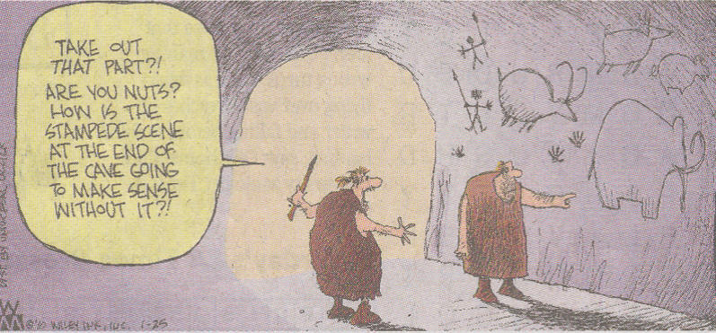
THE FIRST WRITER and EDITOR
Adapted from Non-Sequitor by Wiley, 1-25-10

Slide 41
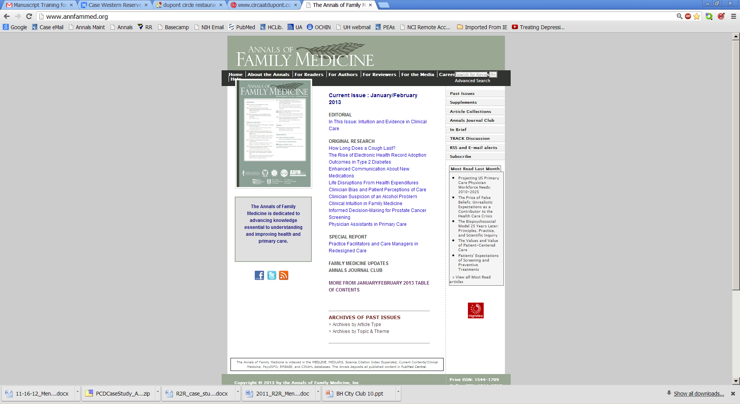


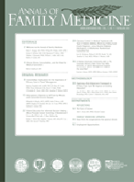







Stanford University Libraries' HighWire Press(TM) assists in the publication of Annals of Family Medicine Online
Current issue
Jul/Aug 2005
The Issue In Brief
Supplement
Prescription for Health
Past issues
May/June 2003- Jul/Aug
2005
Search the Annals
Online Discussions
Discussion of articles
Discussion of other topics
Employment Opportunities
The Annals of Family Medicine is indexed in the MEDLINE, MEDLARS, Science Citation Index Expanded, Current Contents/Clinical Medicine, and PsycINFO databases.

Slide 42
Stanford University Libraries' HighWire Press(TM) assists in the publication of Annals of Family Medicine Online
Mission:
The Annals of Family Medicine is dedicated to advancing knowledge essential to understanding and improving health and primary care. The Annals supports a learning community of those who generate and use information about health and generalist health care.
www.AnnFamMed.org

Slide 43
Additional Resources
Goldman KD and Schmalz KJ. Writing Well: A Writing Style Checklist to Promote Publication Among Practitioners. http://hpp.sagepub.com/content/14/1/5
Academy Health. Writing Articles for Peer-Review Publications: A Quick Reference Guide. http://www.academyhealth.org/files/HIT/writingguide.pdf
Elsevier. How to get Published: Structuring an Article. http://mediazone.brighttalk.com/comm/ReedElsevier/509ba7e7a9-28221-2251-31500
  See other webcasts: http://www.elsevier.com/authors/elsevier-supporting-early-career-researchers/publishing-connect-training-webcasts

